Slide 1

Space related work for students
Emilie Udnæs
18. September 2018
emilieu@stud.ntnu.no

Slide 2
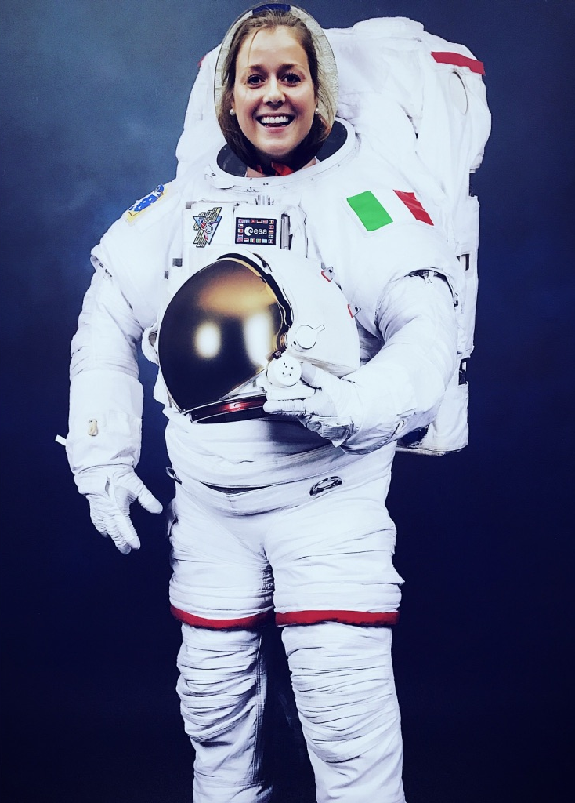
My space background
Msc Electrical Engineering (analog circuit design) @ NTNU
Master thesis: Antenna design for sensor node in the Arctic (@ NTNU Smallsat Lab)
Internship @ Indra Navia (2015)
Starburst internship @ Kongsberg Group (2017)
5 months internship @ ESA (Noordwijk) (2018)
5 months internship @ Yara International (2018)

Slide 3
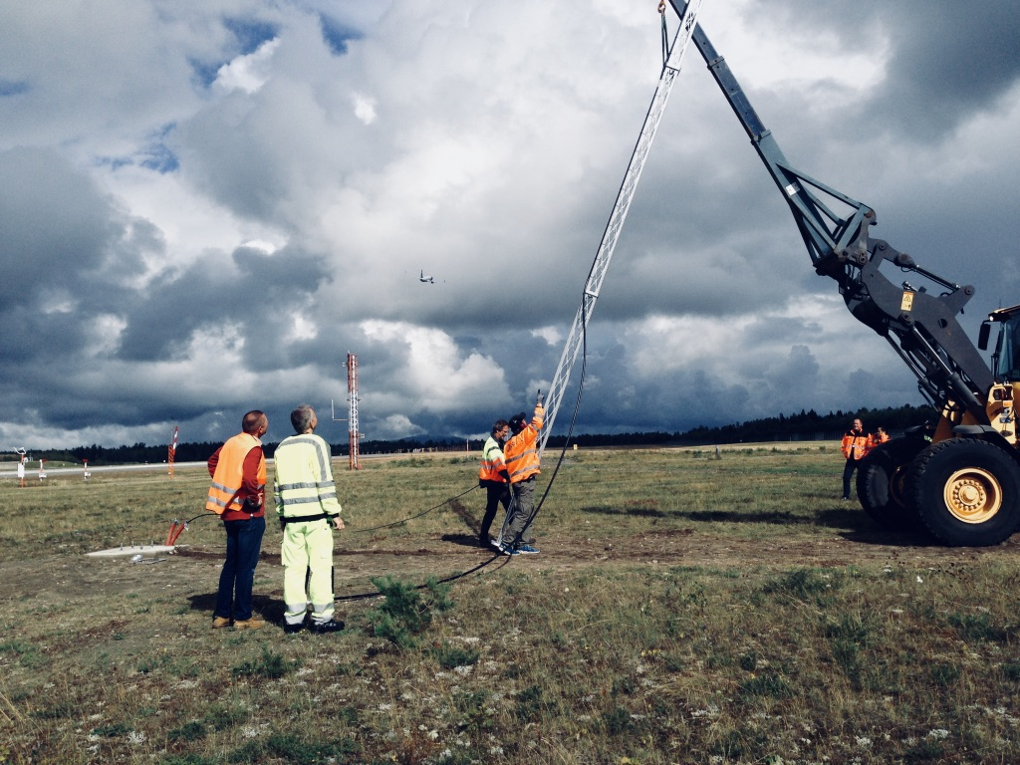
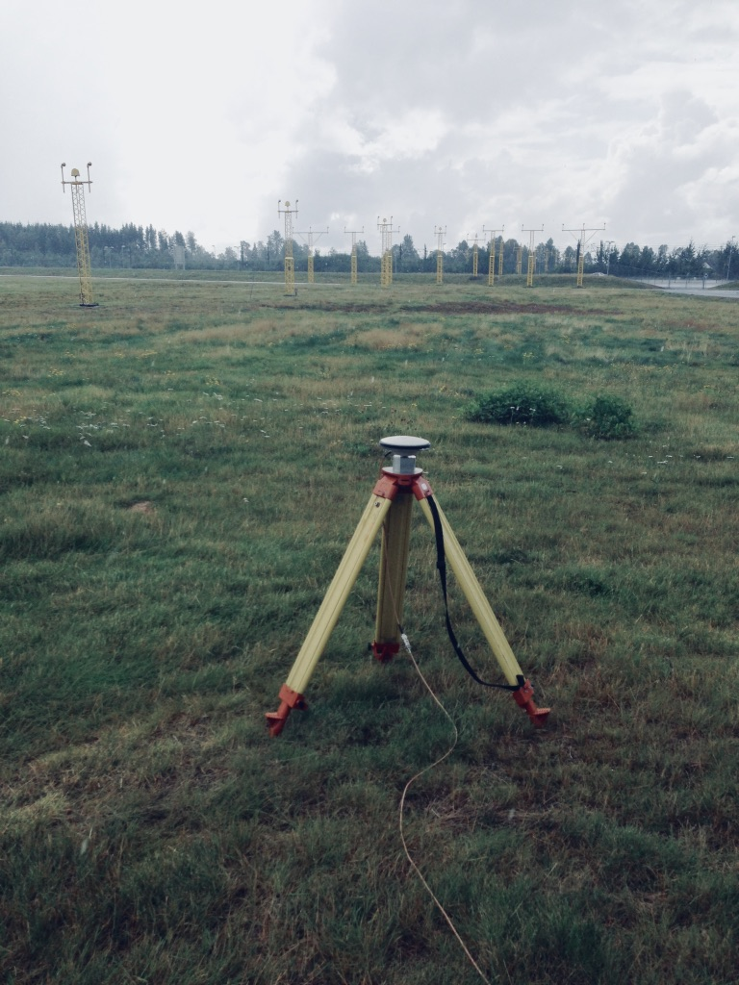
https://indranavia.com/

Slide 4
Video
https://www.youtube.com/watch?v=WLw_QMbuCxI

Slide 5
Summerjob Kongsberg Gruppen
Technical Department
Kongsberg Space Systems (Kongsberg)
Kongsberg Satellite Services KSAT (Tromsø)
Kongsberg Norspace (Horten)
Kongsberg Spacetec (Tromsø) (deadline november 2018)
Deadline: 31.01.2019
https://kongsberg.easycruit.com/vacancy/2142027/61117?iso=no

Slide 6
Opportunities at
Student Internship
600€/month + Erasmus
3-6 months
How to apply:
Online application
CV
Cover letter explaining why you would like to work at ESA
Student enrolment certificate
Tip: make sure that you select a specific area of interest when you apply
Deadline: 15. October 2018
https://www.esa.int/About_Us/Careers_at_ESA/Student_Internships2

Slide 7
Opportunities at
Young Graduate Trainee
12 months
2,300€/month + expatriation and installation allowance
2.5 days paid leave / month
You can only apply for one YGT opportunity
Application on ESA website, interviews in March
Deadline: towards november
https://www.esa.int/About_Us/Careers_at_ESA/Graduates_Young_Graduate_Trainees

Slide 8


Slide 10
Video
http://www.esa.int/spaceinvideos/Videos/2017/12/Christina_s_experience_as_an_ESA_Young_Graduate_Trainee
http://www.esa.int/spaceinvideos/Videos/2017/11/Aleks_experience_as_an_ESA_Young_Graduate_Trainee

Slide 11
International Space University
Space Studies Program (summer school)
Lectures by renowned experts, hands-on activities and projects, team work and professional visits
New location every year
18,500€ (sponsor opportunities by Norwegian Space Centre)
Master of Space Studies
One- or two-year graduate degree program
Primarily in Strasbourg, France
25,000€
Online Applications http://www.isunet.edu
Questions? petter.skanke@spacegeneration.org

Slide 12
Space Generation Advisory Council
Promote the voice of the next generation of space sector leaders on the topic of international space development
Workshops, congress, project groups, scolarships
https://spacegeneration.org
Notes:
Non profit organization which aims to bring the views of students and young space professionals to the United Nations (UN), space industry and other organisations

Slide 13
Student organizations
Propulse NTNU (new this year!)
Design, develop and build a rocket to compete in Spaceport America Cup in New Mexico, USA
Orbit NTNU
Design, develop and build a smallsat
NTNU SmallSat Lab
https://www.ntnu.edu/ie/smallsat
evelyn.livermore@ntnu.no

